Slide 1


Smart Validator
Termsheet Validation Using AI

Slide 2

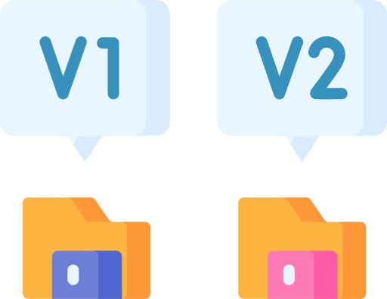






Problem Statement
Multiple versions of Termsheet
Multiple Formats of Termsheet
Economic vs.
Non-Economic
Changes in
Term Sheets
Manual
validation
|Power Ranger SPD

Slide 3



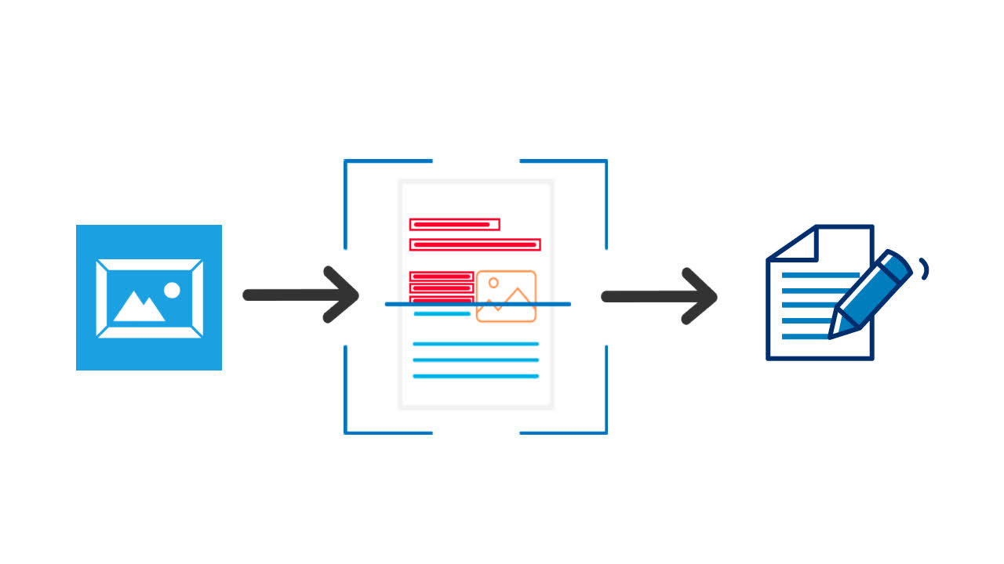




Objective
Automate the validation of term sheets using AI to reduce manual effort and errors.
Enable fast and accurate extraction of key trade details from unstructured documents.
Improve operational efficiency by minimizing processing time and workforce dependency.
Provide a scalable, secure, and auditable solution for end-to-end document validation.
|Power Ranger SPD

Slide 4




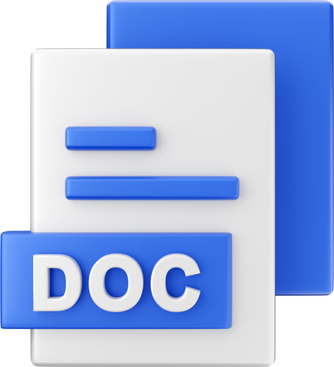






Architecture Overview
Imaplib
Email
Word
Doc
NLP Techniques
&
OCR Techniques
PDF
Hand Written
Doc
Validation
Report
|Power Ranger SPD
Frontend

Slide 5
Email
Architecture
Word
Doc
1. Data Ingestion
PDF
Hand Written
Doc
|Power Ranger SPD

Slide 6
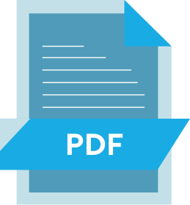


Architecture
2. Data Processing
NLP Techniques
&
OCR Techniques
Validation
| Power Ranger SPD

Slide 7




Architecture
3. Data Validation
|Power Ranger SPD

Slide 8


Business And Revenue Impact
70% Cost Savings
Cutting monthly expenses drastically
85% Workforce Reduction
Smaller, skilled oversight teams
Compliance Savings
Annually reduces penalties
Higher Accuracy
Reduces error rate
|Power Ranger SPD

Slide 9



Speed &
Efficiency
Error
Reduction
Standardization
Benefits
Automate
Validation
Cost
Saving
|Power Ranger SPD

Slide 10




Future Scope & Applications
AI-powered drafting assistance
Predictive risk analysis
Real-time collaboration
Wider industry adoption
Automated compliance checks
|Power Ranger SPD

Slide 11



Our Learnings and Challenges
Bridging technical gaps through domain exploration
Collaborative problem-solving enhanced team collaboration
Security-first mindset in AI deployment
Our five Values – Respect, Integrity, Service, Excellence and Stewardship – are our moral compass

